Slide 1
AAA Noether Core

Slide 2
Binary Capture Builds Stable Tri-Binary Assemblies
A captured binary is stable only when the two orbital axes can close a mutual causal path.
At high energy, binaries may capture one another by piercing the partner orbit.
Bi-binaries are possible metastable intermediates.
Tri-binary assemblies are the stable scaffold candidate for Noether cores.
When an outer tier decays, the exposed bi-binary or uni-binary remnant is more reactive.
+
+
+
−
−
−

Slide 3
Shielding Tiers Expose Deeper Core Energy
Structure Architecture
6 : Total immutable point potentials
3 : electrinos at -e/6
3 : positrinos at +e/6
0 : Personality point potentials
1 : Generation I Noether energy core
Provides 3 dimensions of stability/containment
Implements SU(3) and the strong force
Spin determines chirality of the structure
3 : orbiting electrino : positrino binaries
binaries coupled at different energy scales
binaries tend to orthogonal at v << c.
Structure become increasingly oblate with velocity.
Gen II and Gen III binary energy shielding
Transacts energy in h-bar units
Conserves angular momentum in 3D
Auto synchronizes binary energy (Koide?)
Implements stretchy ruler, variable clock
Is an ideal black body
An essential emergent building block for the universe.
Generation I Fermion Core
Generation II Fermion Core
Generation III Fermion Core
+
I
II
II
III
+
III
+
III
−
−
−
+
+
+
−
−
−
Binary | I | II | III
Energy | E_{I} << E_{II} | E_{II} << E_{III} | E_{III}
Frequency | f_{I} << f_{II} | f_{II} << f_{III} | f_{III}
Radius | r_{I} >> r_{II} | r_{II} >> r_{III} | r_{III}
KE | _{L} | _{M} | _{H}
PE | _{H} | _{M} | _{L}
2D representations of coupled binaries at different energy scales.

Slide 4
Tri-Binaries Scale by Frequency, Radius, and Emission
scaling by orders of magnitude

Slide 5
Neutral Tri-Binary Scaffold
Architecture
6 core architrinos: 3 electrinos + 3 positrinos
3 nested electrino:positrino binaries
neutral scaffold; axial layer is separate
pro/anti branch is ordered tri-binary chirality
shielding lowers externally exposed response
closure target: stability, color recovery, and mass map
+
+
−
+
−
−
2D representation of separated binary energy scales.

Slide 6
Nested Tri-Binary Gyroscopic Closure
+
+
−
+
−
−
J Mark Morris

Slide 7
Phase Locking Near Field Speed
+
+
Point Potential Velocity | Generation
Phase Hypothesis | I | II | III
Binary Max Curvature | ? | ? | max
Decay to binaries? | ? | ? | ?
Inside a black hole | > c_f | >> c_f | >>> c_f
Spacetime assemblies | = c_f | > c_f | >> c_f
? | < c_f | > c_f | >> c_f
Typical Gen I fermion? | < c_f | = c_f | > c_f
? | << c_f | < c_f | > c_f
? | << c_f | < c_f | = c_f
? | <<< c_f | << c_f | < c_f
Generation I
Generation II
Generation III
−
+
−
−
J Mark Morris

Slide 8
Noether-Core Regimes Map to Effective Statistics
Group Velocity
Group Velocity
Group Velocity
+
+
+
−
+
−
+
−
+
−
+
−
+
−
+
−
−
−
Low-drift Noether core
3D exclusion envelope
spin-1/2 closure target
Fermi-Dirac statistics route
pro/anti core chirality retained
e.g., charged leptons and quarks
High-drift Noether core
angular-momentum vectors tend toward axialization
mass response becomes oscillatory
neutrino-like comparison target
claim level: open dynamics route
Velocity >= “c” Noether core
2D boson shape, ~0 exclusion
Spin 1
Bose-Einstein statistics
e.g., photon
J Mark Morris

Slide 9
Angular-Momentum Orientation Encodes Chirality Choices
L
M
S
S
M
L
SLM
SML

Slide 10
Tri-Binaries Have Four Chirality Forms
Tri-binary Forms | Left | Right
Pro
Anti
Place an observer marker at (1,1,1) examining the angular momentum vectors of the three binaries.
Pro and anti are distinguished by the orientation of their angular momentum vectors — HML or HLM
Left/right is the orbital precession direction of the binaries.
The chart shows that tri-binaries have four geometrical variations.
Binaries scale by many orders of magnitude in energy, frequency, radius, and orbital velocity
♧
♢
♤
♡

Slide 11
Triply Nested Binaries with Candidate Axial Sites
+
+
+
−
−
−
Various scales of energy and radii.

Slide 12
Part II: Dynamics and Closure Targets
Claim levels: definition / hypothesis / closure target

Slide 13
Noether-Core Medium Response
Noether cores
Assembly identity belongs to the stable tri-binary scaffold, not to a point-like particle.
Constituent architrinos emit causal wakes; observer-level fields are effective summaries.
The dynamic exclusion envelope depends on energy, cadence, and group velocity.
At low drift speed, cores remain distinct enough to support the Fermi-Dirac route.
Noether-Sea / Higgs-sector response hypothesis
Ambient Noether cores may be strongly shielded and weakly exposed.
Matter assemblies perturb local Noether-Sea cadence, strain, and envelope scale.
The gravity route is a gradient in medium response, not a primitive force label.
Higgs-sector claims remain closure targets until electroweak normalization is derived.

Slide 14
Velocity Retunes Core Geometry
Claim level: closure target.
As assembly drift speed approaches the local effective channel speed, the Noether-core envelope should become more oblate.
The open problem is not the visual flattening alone; the branch ledger must retune across all three binary layers.
Simulation target: solve the tri-binary path-history update and extract radii, frequencies, axes, and active causal roots.
Collider decay should be treated as exposure of inner branch energy, not as free access to isolated constituents.
Question to preserve: can any unshielded fragment cross a Noether core without triggering a reaction channel?

Slide 15
Energy Transfer Retunes the Sea
Claim level: medium-response hypothesis.
Architrinos emit causal wakes at fixed cadence and source amplitude.
A Noether core presents a low externally exposed signature because nested layers shield by superposition.
Matter assemblies perturb neighboring Noether-Sea cores through received wake structure.
Retuning may appear as changed cadence, strain, envelope scale, or coupling to nearby cores.
Mass response should be derived from trapped causal history, shielding, and Noether-Sea coupling.

Slide 16


Open Dynamics Questions
A Higgs cluster has two pro and two anti Noether cores. Do they couple like a Helium nucleus?
Our photon model suggests that counter-rotating binaries strongly couple.
Let’s speculate we are coupling the two poles of the Gen III binary (highest energy binary).
There are 4 Gen III binaries in a Higgs cluster.
We have 8 poles to couple.
Pro1, Pro2, Anti1, Anti2, each with L or R angular momentum
Gen II binaries may also couple. Gen I binaries may also couple
To what degree, if any, do these Gen III axial couplings contribute to assembly shielding?
Two orbiting electrons
pro
anti
binary
Two pro and two anti Noether Cores coupled as a Higgs cluster.
Helium Nucleus
is two protons and
two neutrons
polar vortices
anti
pro
Getty

Slide 17
Lorentz Geometry Closure Target
Claim level: closure target, not completed proof.
At high drift speed, a Noether core should retune its exclusion envelope from a 3D oblate body toward a nearly planar branch.
Canonical variables: β = v/c_f, γ = (1 - β²)^(-1/2), and ξ = R∥/R⊥.
The target is ξ → 1/γ in the homogeneous weak-field limit, with clock-rate extraction kept separate.
Open geometry question: how do pro/anti and left/right chirality labels survive as the core approaches planar alignment?
Strong-field question: do photon-like pro/anti planar pairs remain distinct at the horizon interface, or compress into a reduced branch record?

Slide 18
Lorentz Bridge: Core Geometry
Standard readout
β = v/c_f
γ = (1 - β²)^(-1/2)
clock and ruler effects
AAA geometry bridge
ξ = R∥/R⊥
target: ξ → 1/γ
derive from branch retuning
Canonical split
Standard relativity supplies the tested readout.
AAA must derive that readout from tri-binary retuning.
Branch state tracks radii, frequencies, speeds, axes, causal roots, and wakes.
ξ is a result target, not a definition.

Slide 19
Partner and Self-Emission Questions
Binary Architecture (unperturbed)
When v <= c_f the physics is only due to partner emissions
When v > c_f the physics is due to both partner emissions and self emissions.
Noether Core Architecture
The three binaries have different relationships depending on energy regime of the assembly.
The relationship between generations is complex and depends on physics in each regime.
Higgs spacetime assembly clusters.
Does a Higgs Noether core’s outer binary have v >= c_f.
Standard model assemblies
fermions, photons, (W’s and Z are ephemeral, another topic)
Does the middle binary have s_M ≈ c_f
The quanta h-bar is observable. Therefore, the quanta must remain in the outer binary.
Or this could all be nonsense…. better to simulate

Slide 20
Orbital Orientation Under Acceleration
Orbits are presumably elliptical in an assembly relative frame, with influences from translation, acceleration, gravitational gradient, precession, and self or external perturbations. Studying the ideal circular (e.g., elliptical) orbit is recommended.
It may be fruitful to examine the squashed Noether core with modeled/simulated elliptical orbits.
Is velocity constant or varying in an elliptical orbit? In classical physics velocity varies. Intuitiion : varying.
Do truly exotic stable orbits occur? Are there cases where orbitals depart substantially from planar in the short term?
In an ellipse, the lengths of the semi-major axis ((a)) and the semi-minor axis ((b)) are different.
For an ellipse with semi-major axis ( a ) and semi-minor axis ( b ), there isn’t a simple exact formula for the circumference.
The approximation from Ramanujan is often quite accurate : [ C \approx \pi \left[ 3(a + b) - \sqrt{(3a + b)(a + 3b)} \right] ]
A circle is technically a special case of an ellipse where the two axes are equal (a = b).
For a circle with radius ( r ), the circumference is given by the simple formula: C = 2 pi r
todo: check references and formulas

Slide 21
Oblation and Axial Compression
A bare Noether core is presumably orthogonal on the cartesian planes, with orbital axis coinciding with x, y, z axes
Electron similar but perhaps more chaotic? All personality electrinos acting upon each other.
An orthogonal core would orient to pi/4 in each orbital plan in the vector direction of the group velocity.
In other words, work performed on the Noether core would cause it’s angular momentum vectors to face forward
As velocity increases an orthogonal core will become more oblate, and they will continue to converge symmetrically.
An asymmetric personality layer will distort the orbital planes (or more broadly path equations) at group velocity = 0.
A moving quark starts distorted and becomes more oblate with speed. Even the ideal scenario is complicated analytically.
They all end up with a planar Noether core at s_M ≈ c_f.
Personality charges decay along the way.

Slide 22
Generation-II Symmetry Balance
Presuming self-powering spiral of the unperturbed binary. ( a sort of new thought dec 2024?)
that suggests that Gen III devolves to the maximal curvature binary. (also group v = max?)
there is a duality to maximally dense regions of black hole cores
it consumes all of its PE and converts it to KE.
its orbital velocity = π c_f / 2 on both zonal and meridional rotation axes
And if the Gen II binary has s_M ≈ c_f how is that related? Why would it form that way?
Then the Gen III binary has it’s arbitrary frequency and that’s it.
There would be no balance on either side of Gen II, or frequency relationships?
It is simpler, but would it work?

Slide 23
Symmetry Balancing and Determinism
Claim level: open question.
Assume absolute timespace with point-potential dynamics and delayed causal wakes.
If stable Noether cores are dominant survivors, the symmetry-balancing condition must be a dynamical basin, not a postulate.
Candidate pivot: the middle binary rides near field speed, s_M ≈ c_f, while inner and outer layers retune.
Open burden: prove whether identical starting states remain deterministic once path-history ledgers and self-hit roots are fixed.
Preserve as appendix material until the branch certificate can test it.

Slide 24
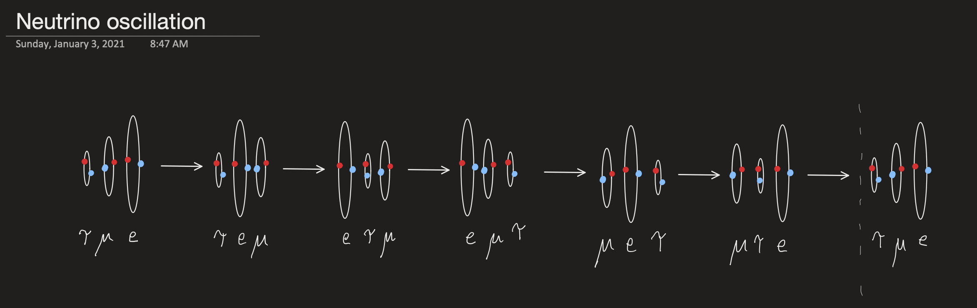
Comparison Target: Neutrino Oscillation
Not sure if neutrino musings go here

Slide 25
AAA Emergent Interactions

Slide 26
Four Effective Forces from Assembly Coupling
PERSONALITY
PERSONALITY
ELECTRO
MAGNETIC
NOETHER CORE
NOETHER CORE
STRONG gluon
GRAVITY is caused by
Emitted potential exciting
Spacetime Noether cores
Which then change shape
WEAK

Slide 27
Gravity as Noether-Sea Response
All matter assemblies continuously exchange wake-mediated energy with neighboring assemblies.
When standard matter changes local medium response, the Noether Sea retunes cadence, strain, and envelope scale.
A gradient in that response is the proposed route to observer-level gravity.
This is a closure target: derive the effective force law and PPN limits from the medium-response variables.

Slide 28
Effective Force Unification
Photons have a 6/6 composition of electrinos and positrinos.
Superfluid is mostly slow photons and neutrinos, around 2.7 Kelvin.
The chart shows gravity beginning near 10⁻³² Kelvin and 10⁻⁴³ seconds.
It seems that the emergence of the spacetime aether is primarily due to redshifting photons and neutrinos.
Credit: Colby College

Slide 29
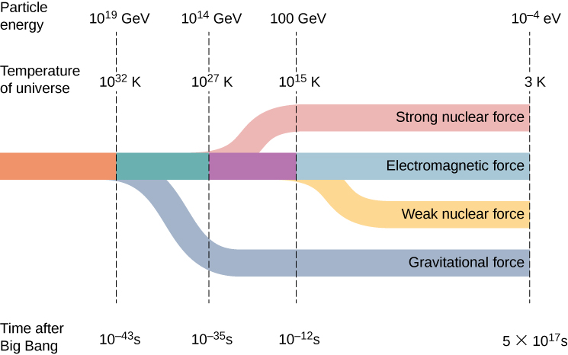
Standard Force Scale: Comparison Reference
Quark
Confinement
Neutrino
Transparency
Photon
Transparency
Inflation

Slide 30
Appendix: Open Symmetry Questions
Preserved as hypothesis material

Slide 31
Closure Target: Symmetry Breaking at the Middle Binary
Hypothesis: the middle binary is the field-speed hinge of the tri-binary.
Terminal target: s_M = c_f with radius/frequency retuning.
Planck-scale framing maps to tri-binary alignment unless a separate derivation links it elsewhere.
Useful estimate: 2π R_M ν_M ≈ c_f.
Open task: derive which Planck constants, if any, follow from middle-binary closure rather than importing them.
Closure question: when angular momentum enters from an external assembly, which layer accepts the action transaction?
J Mark Morris

